Slide 1
TESTING AND DEBUGGING (UNIT TESTING AND AUTOMATION)
SOFTWARE DEVELOPMENT TOOLS WEEK 8 PRESENTATION GROUP ONE
DEMONSTRATION OF TESTING STRATEGIES AND AUTOMATION TEST PIPELINES

Slide 2
INTRODUCTION
SOFTWARE TESTING is the process of checking if the your code works as intended with the goal of finding and fixing errors before they are given to users
Though there are different types of testing like system testing, performance testing etc, we will focus on unit testing which is testing individual components or units in a system to ensure they work properly
Automated testing using GitHub Action involves automatic test that occur on every push or pull request in the GitHub repository. It helps detect bugs e

Slide 3
And this is implemented using testing frameworks,

Slide 4
Tools used (testing frameworks)
A TESTING FRAMEWORK is a set of tools and libraries that provide a structured environment for creating and running automated tests.
Since our backend was implemented using Node.Js on which JavaScript code runs we will test with Jest

Slide 5
Carrying out the Unit testing
Creation of units: Break the software into smaller, testable units (e.g., functions, methods, or classes).
Writing test cases: Create test cases to cover all possible inputs and outputs, including edge cases
Execute tests: Run test cases using tools or manually verify their correctness.
Verifying results: Check if the actual output matches the expected output.
Fixing of errors: If issues are found, fix the code and re-test the unit until all tests pass.

Slide 6
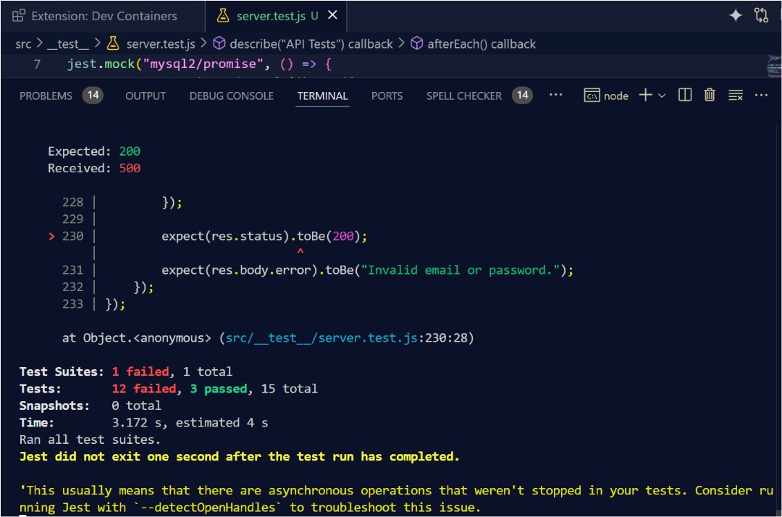
Implementation: Unit testing on the backend and apis
The login endpoint tests ( POST /api/login) check for missing fields, invalid credentials and successful login attempts. When testing successful logins, the code uses bycrypt to hash passwords and verifies that the response includes a cookie with the authentication token

Slide 7
Automated GitHub testing
This involves running software test cases automatically whenever changes are pushed to our github repository. This ensures the code pushed is tested in real time to improve reliability and efficiency

Slide 8
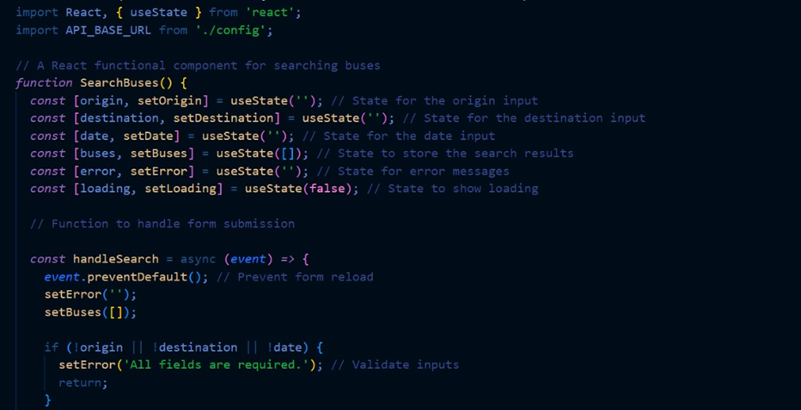
Steps to implement AUTOMATED GITHUB TESTING
Setting Up a testing framework, Jest
Writing Automated Tests

Slide 9
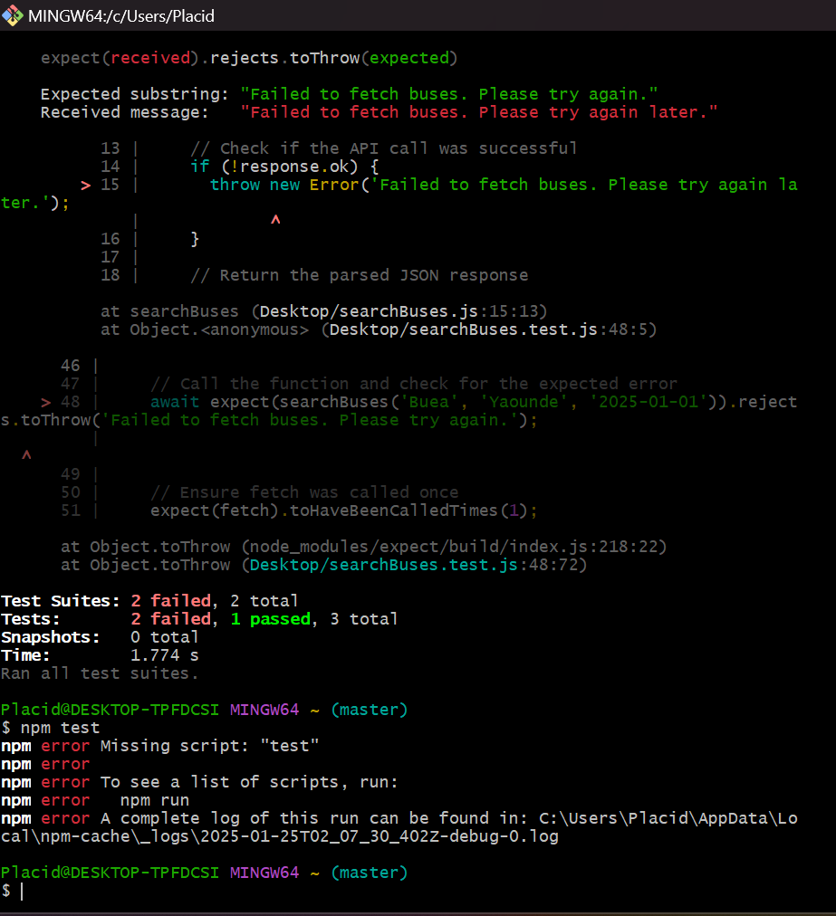
Integrate with Continuous Intergration Tool, GitHub Actions
This involves running software test cases automatically whenever changes are pushed to our github repository.
Configuring GitHub workflow

Slide 10
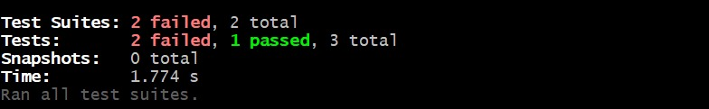
Test results

Slide 11
Cloud deployment with docker
SOFTWARE DEVELOPMENT TOOLS WEEK 10 PRESENTATION GROUP ONE
Containerizing our application and docker setup

Slide 12
INTRODUCTION
proper intro
So to deploy our website, it has to be containerized
Docker is an open source platform that allows us to build, ship and run applications inside containers
Containers provide a lightweight and portable way to package applications and it dependencies together ensuring consistent behavior across different environments

Slide 13
Key concepts
Docker images: Read only templates that serve as building blocks for containers. They contain the application, code, libraries and dependencies
Docker containers: Running instances of a docker image. Each container runs in isolation, sharing the host machine’s kernel but having its own file system and resources
Docker compose: a tool for defining and running multi-container docker applications. Use to orchestrate the deployment of multiple services that work together, just like in our website

Slide 14
Containerizing and deployment
To deploy, docker files for the frontend (react.js), backend (node.js) have to be created

Slide 15
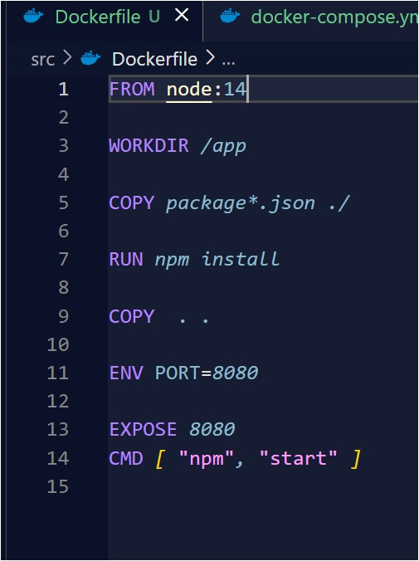
1. Creating a dockerfile for the node.js backend
Base image: The official Node.js as base image from dockerHub
Work Directory: Setting the working directory in the container
Copy package.json and package-lock.json to container
Install Dependencies defined in the package.json
RUN npm install
Copy application code
Expose port
Define the command to run your Node.js app
image

Slide 16
Creating a dockerfile for the react frontend
Similar procedures were followed from
Choosing a base image for the react application, setting the work directory within the container, copying dependencies to installing dependencies are all followed again.
But the following steps here are;
Building the application using npm run build.
Copy build artifacts
Start a simple HTTP Server

Slide 17
Creating a docker-compose.yml file
Compose simplifies the control of the entire application stack, making it easy to manage the services, networks and volumes in a single comprehensible YAML configuration file, compose.yml
To create and manage the file, the following steps are taken
Create a file called compose.yaml in the project directory in which we define the two services for the backend and frontend images we initially created.
We then build and run

Slide 18
Building and running docker images
Build: After building the docker images for both services using docker compose and starting them using docker-compose build and
Run: On the Docker CLI, we can use the docker-compose up –d to start the containers in detached mode
We can edit the compose.yaml file in our project directory to use watch so we can preview the running Compose services which are automatically updated as file is edited
We access the exposed port to see the application running

Slide 19
deployment
Choose a cloud provider,
Creating a container orchestration service, kubernetes
Deploy the docker compose configuration to kubernetes

